Slide 1
The Standard Model
Distances in space
Expanding Universe
Big Bang Theory
Future of the Universe
Particle accelerators
The Standard Model
Antimatter
Hadrons
Leptons
Fundamental forces
The Big Bang and the Standard Model

Slide 2
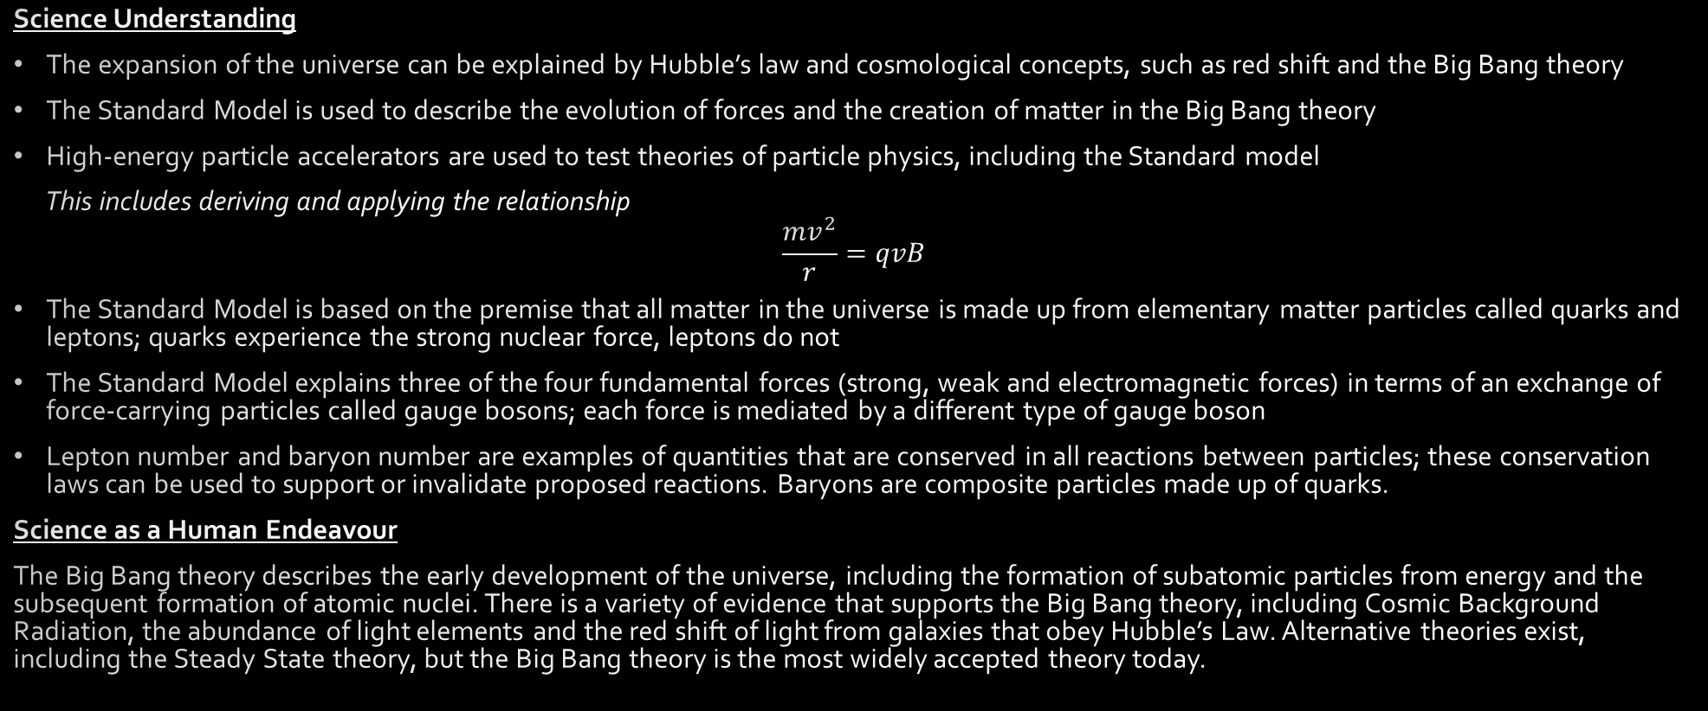
SCSA ATAR Syllabus (last updated 29/11/19; https://senior-secondary.scsa.wa.edu.au/syllabus-and-support-materials/science/physics)
Science Understanding
The expansion of the universe can be explained by Hubble’s law and cosmological concepts, such as red shift and the Big Bang theory
The Standard Model is used to describe the evolution of forces and the creation of matter in the Big Bang theory
High-energy particle accelerators are used to test theories of particle physics, including the Standard model
This includes deriving and applying the relationship
$$\frac{mv^{2}}{r}=qvB$$
The Standard Model is based on the premise that all matter in the universe is made up from elementary matter particles called quarks and leptons; quarks experience the strong nuclear force, leptons do not
The Standard Model explains three of the four fundamental forces (strong, weak and electromagnetic forces) in terms of an exchange of force-carrying particles called gauge bosons; each force is mediated by a different type of gauge boson
Lepton number and baryon number are examples of quantities that are conserved in all reactions between particles; these conservation laws can be used to support or invalidate proposed reactions. Baryons are composite particles made up of quarks.
Science as a Human Endeavour
The Big Bang theory describes the early development of the universe, including the formation of subatomic particles from energy and the subsequent formation of atomic nuclei. There is a variety of evidence that supports the Big Bang theory, including Cosmic Background Radiation, the abundance of light elements and the red shift of light from galaxies that obey Hubble’s Law. Alternative theories exist, including the Steady State theory, but the Big Bang theory is the most widely accepted theory today.

Slide 3
Fleeing stars
Careful consideration of stellar spectra shows that the light from all distant stars is red-shifted
It seems that all distant stars are moving away from us
Careful measurement must be made to understand problem
Degree of red-shift varies between stars – why?
Is there a pattern?
Collect more data about the stars – start with how far away they are

Slide 4
Cosmological distances
“Space is big. Really big. You just won't believe how vastly, hugely, mind-bogglingly big it is. I mean, you may think it's a long way down the road to the chemist, but that's just peanuts to space.”
Douglas Adams
m and km rapidly become inadequate in space – need new units for distances in space:
Astronomical units
Lightyears
Parsecs (Parallax-seconds)

Slide 5
Astronomical units
1 AU = Roughly the distance from the Earth to the Sun
1 AU = 149597870700 m
According to datasheet 1 AU = 1.5 x 10¹¹ m
Normally only used within solar system

Slide 6
Lightyears
1 ly = the distance light travels in a year
1 ly = 1 x 365 x 24 x 60 x 60 x 3 x 10⁸
According to datasheet 1 ly = 9.46 x 10¹² km
Useful at larger scales, intuitive to understand

Slide 7
Parsecs (Parallax seconds)
1 pc = Distance at which 1 AU subtends and angle of 1 arcsecond (1/3600 of a degree)
According to datasheet 1 pc = 3.26 ly
Inherently related to the method we use to measure the distance to near stars but difficult to understand

Slide 8
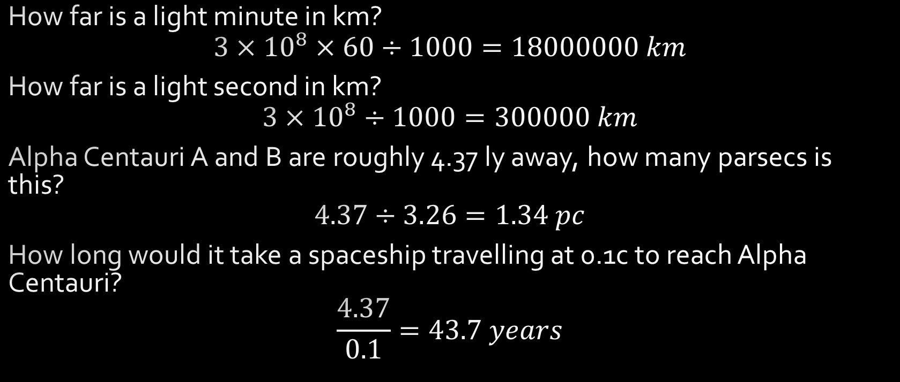
Examples
How far is a light minute in km?
$$3×{10}^{8}×60÷1000=18000000 km$$
How far is a light second in km?
$$3×{10}^{8}÷1000=300000 km$$
Alpha Centauri A and B are roughly 4.37 ly away, how many parsecs is this?
$$4.37÷3.26=1.34 pc$$
How long would it take a spaceship travelling at 0.1c to reach Alpha Centauri?
$$\frac{4.37}{0.1}=43.7 years$$

Slide 9
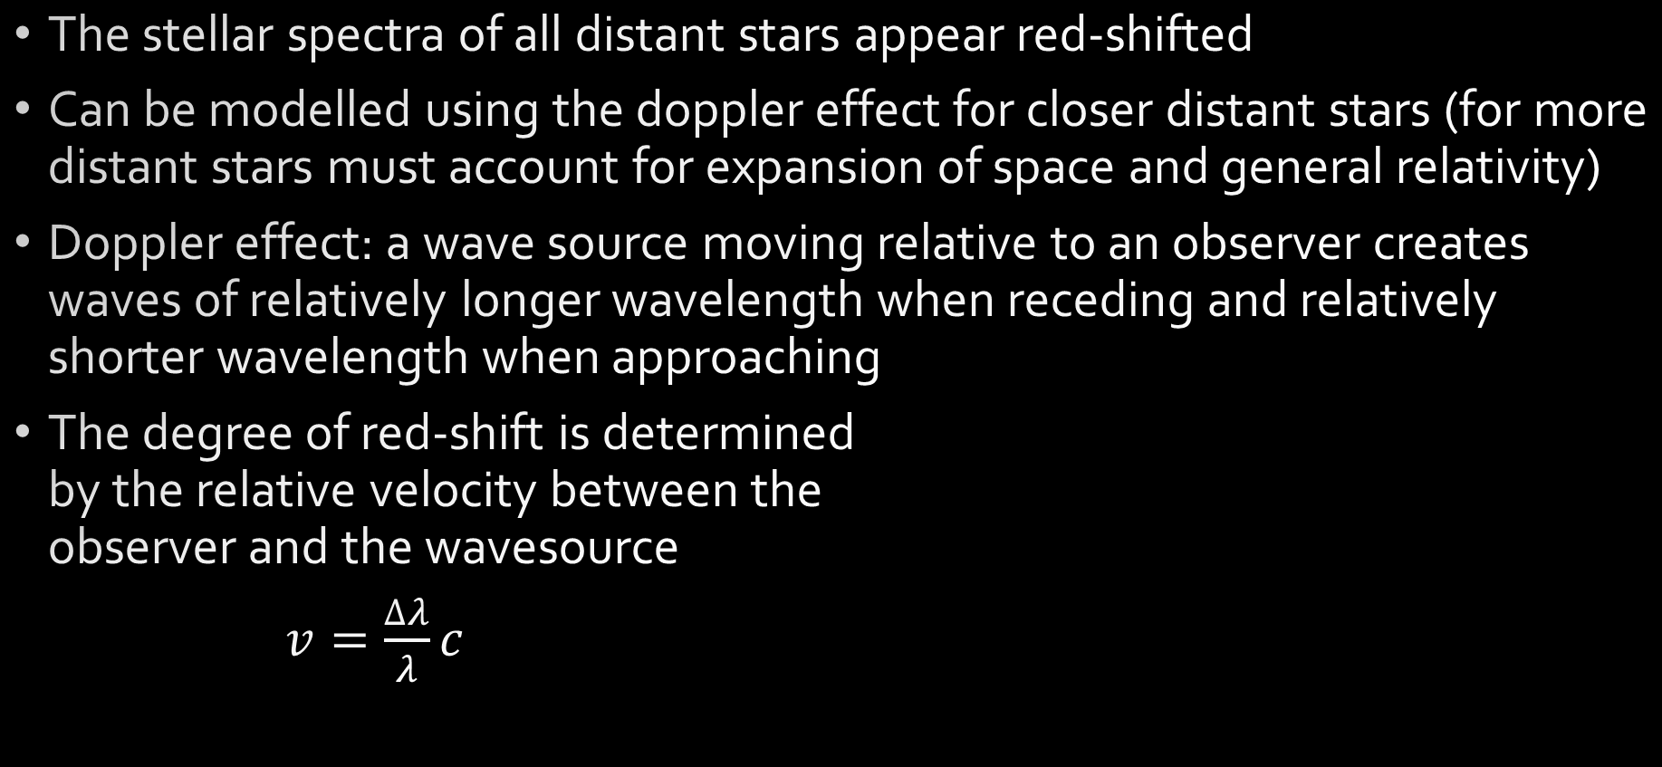
Red-shift
The stellar spectra of all distant stars appear red-shifted
Can be modelled using the doppler effect for closer distant stars (for more distant stars must account for expansion of space and general relativity)
Doppler effect: a wave source moving relative to an observer creates waves of relatively longer wavelength when receding and relatively shorter wavelength when approaching
The degree of red-shift is determined by the relative velocity between the observer and the wavesource
$v=\frac{∆λ}{λ}c$

Slide 10
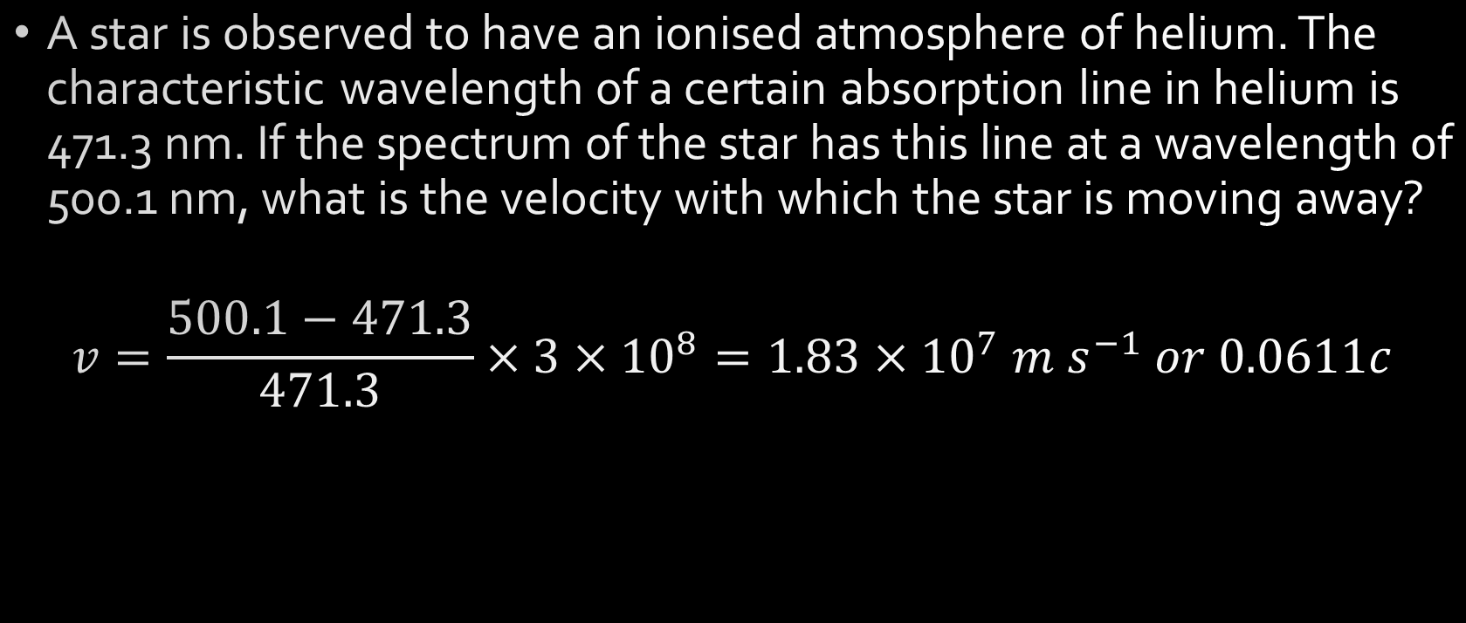
Example
A star is observed to have an ionised atmosphere of helium. The characteristic wavelength of a certain absorption line in helium is 471.3 nm. If the spectrum of the star has this line at a wavelength of 500.1 nm, what is the velocity with which the star is moving away?
$$v=\frac{500.1−471.3}{471.3}×3×{10}^{8}=1.83×{10}^{7} m s^{−1} or 0.0611c$$

Slide 11
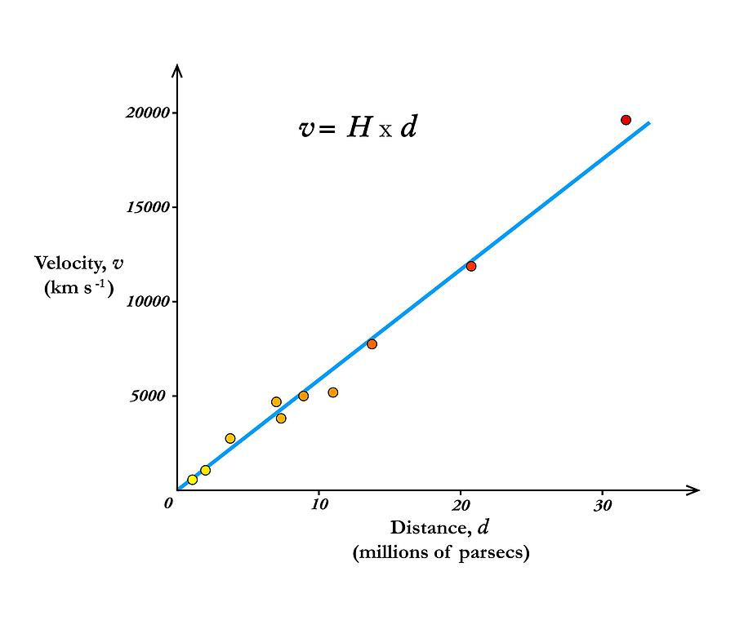
Hubble’s Law
We can measure:
the degree of red-shift of each star – indication of how quickly it is moving away from us
the distance to each star
A linear relationship becomes apparent:
The velocity of galaxies receding from Earth is roughly proportional to their distance from Earth

Slide 12

Hubble’s Law
$$v=H_{0}D$$
$$v=recessional velocity (m s^{−1})$$
$$H_{0}=Hubble constant=2.29×{10}^{−18} s^{−1}$$
$$D=proper distance from galaxy to observer (m)$$
Hubble constant is not a true constant, it varies over time but is theoretically a constant across the universe at any given point in time

Slide 13
Interpreting Hubble’s Law
What does it mean that all distant galaxies are moving away from us and that the further from us they are, the faster they are moving away?
Cannot be explained by saying all stars are exploding outwards from us – would expect all distant galaxies to be moving away at the same speed
Cannot be explained by saying all stars are exploding out from a point distant to us – would not expect a linear relationship in all directions
Can be explained by saying that space itself is expanding – all galaxies are effectively moving away from each other, the further apart they are, the faster they are effectively moving apart
Think of points on the surface of a balloon as it is inflated – the rubber (space) expands causing the points to become further apart even if they are not moving across the rubber (through space) themselves

Slide 14
Implications of Hubble’s Law
Space itself is expanding
Tracking backwards through time there is a point where space would contract back to a singularity – age of the universe
Expansion of space out from some beginning referred to as the Big Bang theory
the Big Bang is not a conventional explosion – does not require a center of the universe – universe may well be infinite in extent

Slide 15

Age of the universe from Hubble constant
Any distant galaxy is believed to have previously been with us in the singularity, if we know how fast it is moving away and how far away it is, we should be able to determine how long it has been moving
$$v=\frac{s}{t} v=H_{0}D$$
$$\frac{s}{t}=H_{0}D$$
$$\frac{1}{t}=H_{0}$$
$$t=\frac{1}{H_{0}}$$
So, the age of the universe can be found as the inverse of the Hubble constant (be careful with units)
Limitation – the Hubble constant is not truly a constant, should account for increasing rate of expansion

Slide 16
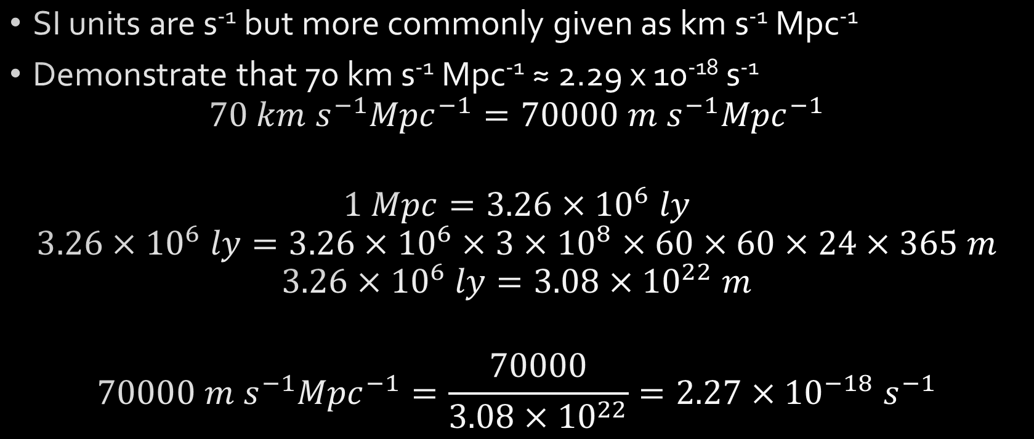
Units for Hubble ‘constant’
SI units are s⁻¹ but more commonly given as km s⁻¹ Mpc⁻¹
Demonstrate that 70 km s⁻¹ Mpc⁻¹ ≈ 2.29 x 10⁻¹⁸ s⁻¹
$$70 km s^{−1}{Mpc}^{−1}=70000 m s^{−1}{Mpc}^{−1}$$
$$1 Mpc=3.26×{10}^{6} ly$$
$$3.26×{10}^{6} ly=3.26×{10}^{6}×3×{10}^{8}×60×60×24×365 m$$
$$3.26×{10}^{6} ly=3.08×{10}^{22} m$$
$$70000 m s^{−1}{Mpc}^{−1}=\frac{70000}{3.08×{10}^{22}}=2.27×{10}^{−18} s^{−1}$$

Slide 17
Big Bang Theory development timeline
1912 Vesto Slipher recognizes spectral shift in distant stars - determines that distant spiral galaxies are receding from the Earth
1915 Albert Einstein’s theory of General Relativity only works for either an expanding or contracting universe – Einstein thinks this is an error, begins looking for a way to adjust it to a static universe
1927 Georges Lemaître (catholic priest/professor of physics) suggests that expanding universe could be traced back to an originating single point
1929 Edwin Hubble demonstrates the relationship between recession velocity and distance for distant galaxies
1931 Georges Lemaître suggests hypothesis of the primeval atom – universe begins with the ‘explosion’ of a ‘primeval atom’ – start of the Big Bang theory
1931 Einstein abandons attempts to force General Relativity to fit a static universe

Slide 18
Big Bang Theory development timeline continued
1948 Bondi, Gold and Hoyle suggest that while the universe is undeniably expanding there is new matter coming into existence maintaining a constant density – Steady-state model
1948 Alpher and Herman recognize that there should be radiation left over from early in the Big Bang which should now be stretched due to the expansion of space to microwave radiation – this radiation should be uniformly distributed throughout space
1964 Penzias and Wilson are trying to study microwave radiation from space but their antenna picks up annoying background signal from all directions – assume it is an error in their equipment – Robert Dicke who had independently come to the same conclusions as Alpher and Herman hears of their trouble and recognizes the background signal for what it is – Cosmic Microwave Background Radiation – evidence supporting the Big Bang theory – death-knell for Steady-state model

Slide 19
Rival theories
Big Bang theory (1931-present) | ‘modern’ Steady-state model (1948-1970s)
Infinite universe: universe has no edge, has no center
Expanding universe: space is expanding between galaxies
Isotropic universe: universe has no preferred orientation – looks the same viewed in/from all directions
Homogenous universe: even distribution of matter through the universe at the large scale – looks the same in all places
Universal laws of physics: physical constants and laws are the same throughout the universe
13.8 billion year old evolving universe: space, time and maybe even the laws of physics come into existence at a specific point in time, all matter came into being very early after the Big Bang, density of matter in the universe decreasing as space expands, allows for an end of the universe | Eternal universe: no beginning or end – looks the same at all times, new matter created constantly between galaxies to maintain density of matter in the universe
These tenets should not be taken as fact per se, they are the current assertions, but some research is showing little hints that things may not be quite as simple as this – for the moment the Big Bang theory remains our best theory by far

Slide 20
Evidence – expansion of space and evolution of galaxies
Expansion of space
Red-shift of distant galaxies, degree of red-shift increasing with distance – expanding space
If space is expanding, tracing it back through time would lead to a point where all matter and space was together in a singularity
Observations of galaxy formation and evolution and the distribution of large-scale cosmic structures
detailed observations of the shape and distribution of galaxies and quasars agree with predictions of the Big Bang Theory
galaxies of different ages appear notably different (not compatible with steady state model)

Slide 21
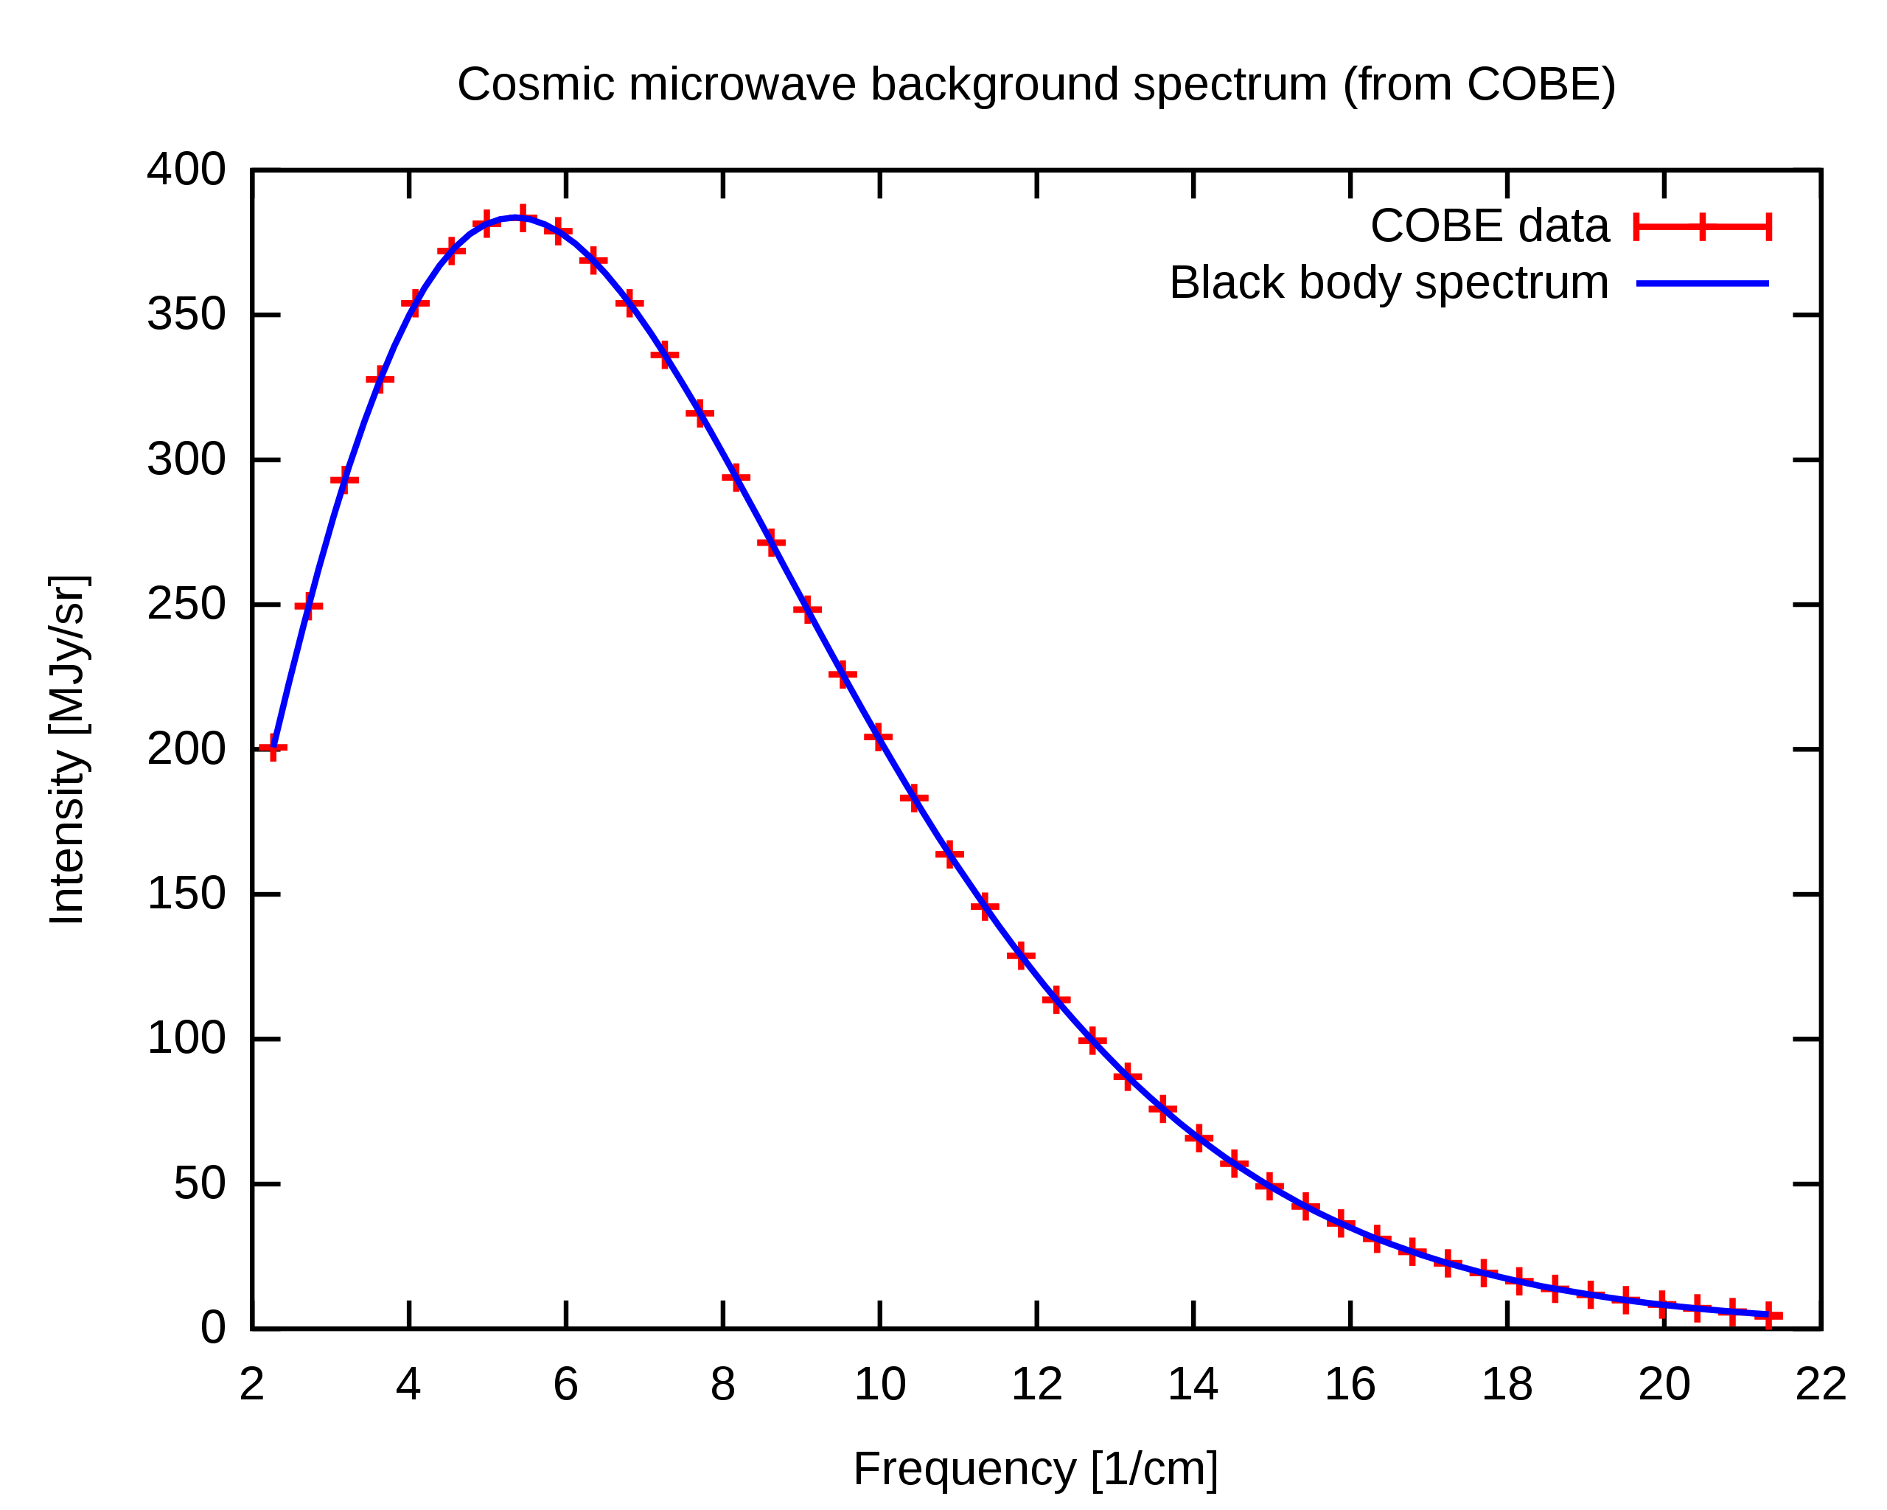
Evidence - Cosmic microwave background radiation
Early Universe should have been filled with high energy radiation matching a high temperature blackbody spectrum
The radiation should still be present in the universe but with its wavelength increased by the expansion of space so it should now match a lower temperature blackbody spectrum
The match of the data to the theory is essentially perfect
The graph to the right shows the theory in blue and high precision measurements of CMBR in red – the error bars for the measurements are much too small to be visible on the graph even if the graph were enlarged
https://www.twig-world.com/film/nobel-prize-by-chance-863/

Slide 22
Evidence – relative abundances of light nuclei
the Big Bang Theory suggests that early in the universe protons and neutrons were formed and were then able to undergo reactions to form isotopes of hydrogen, helium and lithium – nucleosynthesis
This would only have occurred over a short timespan (~20 minutes), once the universe was cool enough for deuterium to be stable but while it was still hot and dense enough for fusion reactions to occur at a significant rate
This leads to very specific predictions about the ratios of the abundance of these isotopes in the universe – relative to H-1 (⁴He/H, ³He/H, ²H/H and ⁷Li/H)
Our best measurements of these ratios agree reasonably well with these predictions and there’s no particular reason they should without the Big Bang Theory

Slide 23
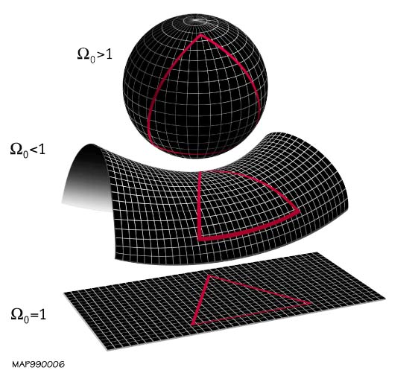
Possible futures of the universe
Space is expanding but gravity could stop it
if the density of matter in the universe is high enough (>10 H atoms per m³) then space has positive curvature, gravity should be able to slow and then reverse the expansion of the universe – Big Crunch
If the density of matter is t0o low (<10 H m⁻³), then space has negative curvature, gravity will slow the expansion but never stop it – Big Freeze
If the density of matter is the critical density then space has zero curvature, the expansion will stop after an infinite amount of time – Big Freeze
Our best measurements of the density of matter/curvature of the universe suggests it is flat – so the expansion of space should be slowing

Slide 24
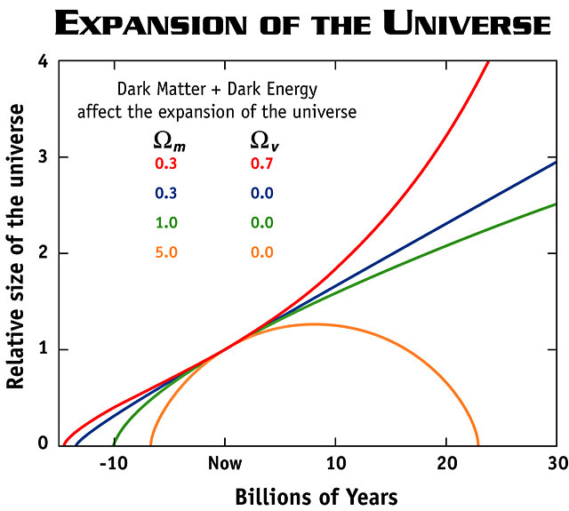
Accelerating expansion of space – dark energy
However, the expansion seems to be accelerating and this is thought to be caused by dark energy
Dark energy remains mysterious but can be thought of as fundamental energy of space that exerts a negative gravitation
As the universe expands the density of matter decreases but the density of dark energy would remain more or less the same – accelerating expansion

Slide 25
Big Freeze
Given the accelerating expansion the most likely scenario for the end of the universe is the Big Freeze:
Space between cluster of galaxies will grow at increasing rate
Supplies of gases need to form stars will deplete
Existing stars will run out of fuel and cease to shine
Universe will grow darker
If protons are unstable then stellar remnants will disappear
Eventually even black holes will evaporate through Hawking radiation
The universe will approach a uniform temperature – no work will be possible

Slide 26
High energy particle accelerators
Mathematical modelling can make quite specific predictions about high energy systems – difficult to test in a laboratory
Particle colliders attempt to test these predictions by accelerating particles to close to the speed of light and then colliding them with other particles head on
The total energy of the particles in a collision will be conserved as mass and kinetic energy
With enough energy, collisions can create particles with more mass than that of the initial particles

Slide 27
Large Hadron Collider (LHC)
“Despite my resistance to hyperbole, the LHC belongs to a world that can only be described with superlatives. It is not merely large: the LHC is the biggest machine ever built. It is not merely cold: the 1.9 kelvin (1.9 degrees Celsius above absolute zero) temperature necessary for the LHC’s superconducting magnets to operate is the coldest extended region that we know of in the universe—even colder than outer space. The magnetic field is not merely big: the superconducting dipole magnets generating a magnetic field more than 100,000 times stronger than the Earth’s are the strongest magnets in industrial production ever made. And the extremes don’t end there. The vacuum inside the proton-containing tubes, a 10 trillionth of an atmosphere, is the most complete vacuum over the largest region ever produced. The energy of the collisions are the highest ever generated on Earth, allowing us to study the interactions that occurred in the early universe the furthest back in time.”
Lisa Randall, 2011

Slide 28
Large Hadron Collider (2008-present)
The LHC accelerates protons to 0.999 999 99c, giving them 6 500 GeV of energy, allowing for collisions of 13 000 GeV
Protons normally have a mass corresponding to 0.9 GeV of energy, so these collisions include roughly 7000 times the energy in 2 protons allowing for the creation of much more massive particles
Head on collisions such as this allow for more of the energy to become mass than possible by colliding with a stationary target

Slide 29
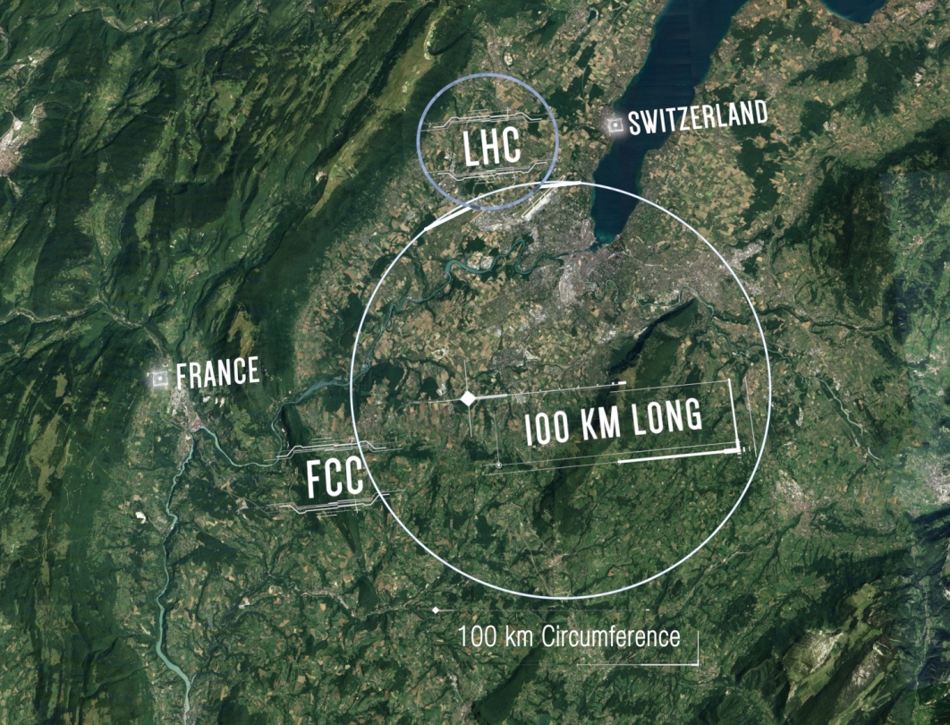
Future Circular Collider (FCC)
Proposed to be ready for operation in the late 2050s
Aiming for energies of 100 TeV compared to 6.5 TeV from the LHC

Slide 30
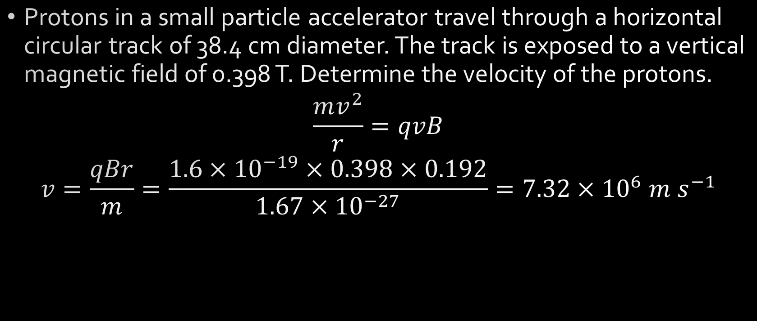
Example
Protons in a small particle accelerator travel through a horizontal circular track of 38.4 cm diameter. The track is exposed to a vertical magnetic field of 0.398 T. Determine the velocity of the protons.
$$\frac{mv^{2}}{r}=qvB$$
$$v=\frac{qBr}{m}=\frac{1.6×{10}^{−19}×0.398×0.192}{1.67×{10}^{−27}}=7.32×{10}^{6} m s^{−1}$$

Slide 31
Particle physics
By the early 1960s experiments with particle accelerators had discovered more than 100 sub-atomic particles such as the kaon, the lambda and the omega
This enormous collection of particles were all thought to be fundamental, indivisible
In 1964 Gell-Mann and Zweig proposed that many of these particles weren’t fundamental but that they were composed of differing combinations of smaller particles - quarks
It is almost impossible to observe lone quarks so the theory was initially contentious, but many experiments continue to confirm and develop the theory

Slide 32
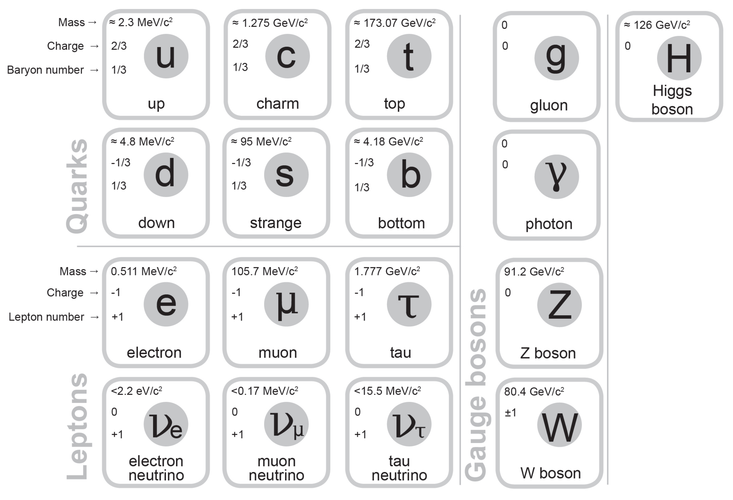
Fundamental particles of matter
It was discovered that combinations of just 6 quarks could explain a very large number of the particles - e.g. a proton is two up quarks and one down quark
These particles, made of two or more quarks are known as hadrons
Hadrons could not quite account for all particles – there were other particles that did not experience the strong force – these are known as leptons and include electrons
All matter is made of combinations of these 12 fundamental particles – the matter we commonly interact with uses just up quarks, down quarks and electrons

Slide 33
Fundamental forces
Experiments with particle accelerators also developed our understanding of three of the four fundamental forces – electromagnetism, the strong force and the weak force
These forces are understood to be mediated by the exchange of force carrier particles known as gauge bosons
The strong force is mediated by gluons (and mesons)
Electromagnetism is mediated by photons
The weak interaction is mediated by W⁺, W⁻ and Z⁰ bosons
Gravity may be mediated by a hypothetical graviton but there is currently no quantum theory of gravity

Slide 34
Extension - Virtual particles
Quantum field theory suggests the universe is filled with multiple overlapping fundamental fields
The fundamental particles are then excitations in these fields so an electron would be an excitation of the electron field – we perceive these excitations as particles at most scales (wave-particle duality)
The gauge bosons as force carriers typically occur as virtual particles
Virtual particles are temporary excitations and cannot be directly observed – they transfer energy, charge and/or momentum between particles
Ordinary (non-virtual) photons are common in everyday conditions, ordinary versions of the other carrier particles are not

Slide 35
Higgs boson
The Higgs field is responsible for mass – the Higgs boson is the excitation of the Higgs field and is significant because it is taken of proof of one of the key predictions of the standard model - as proof of the existence of the Higgs field
It can be thought of as a carrier particle, like the other fundamental bosons, but it is not exactly a force carrier because mass is not a force – it is a boson, but not a gauge boson (gauge bosons are vector bosons while the Higgs boson is scalar – forces have direction while mass does not)

Slide 36
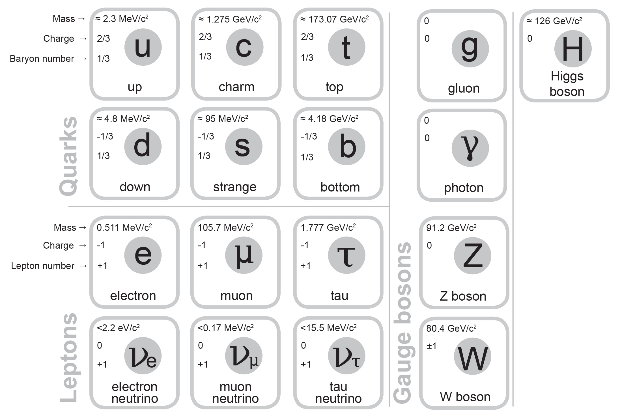
The Standard Model
This leads to the Standard Model – we have a set of fundamental particles that are responsible for all matter and force (apart from gravity)

Slide 37
Understanding the Standard Model table
Our version of the table lists mass and charge for each particle, baryon number for the quarks, and lepton number for the leptons
Mass is given as a quantity of energy/c² we need to be able to convert that to kg
Charge is fractional for quarks
Note that there are two W bosons, one with a charge of +1 and one with a charge of -1

Slide 38
Antimatter basics
Matter and antimatter are equal opposites that cancel out - annihilate
Antimatter is every bit as ‘real’ and observable as matter (just rarer)
Antimatter particles are ‘twins’ of matter particles with the opposite electric charge (except for uncharged particles)
When a matter particle meets its antimatter twin, they are both destroyed releasing energy (typically as photons)
All quarks and leptons have antimatter twins, photons and gluons do not, W⁺ and W⁻ are each others' antiparticles while Z⁰ is its own antiparticle
Note that antimatter is a completely separate concept from dark matter which refers to hypothetical matter that we cannot directly observe

Slide 39
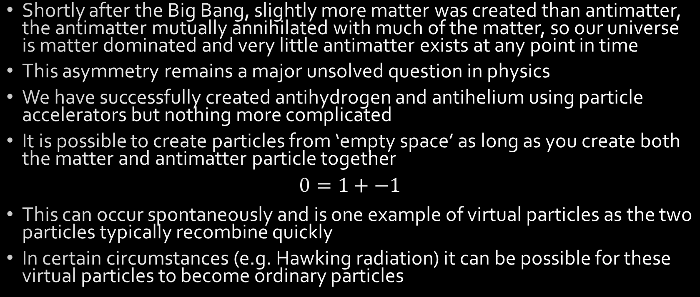
Antimatter details
Shortly after the Big Bang, slightly more matter was created than antimatter, the antimatter mutually annihilated with much of the matter, so our universe is matter dominated and very little antimatter exists at any point in time
This asymmetry remains a major unsolved question in physics
We have successfully created antihydrogen and antihelium using particle accelerators but nothing more complicated
It is possible to create particles from ‘empty space’ as long as you create both the matter and antimatter particle together
$$0=1+−1$$
This can occur spontaneously and is one example of virtual particles as the two particles typically recombine quickly
In certain circumstances (e.g. Hawking radiation) it can be possible for these virtual particles to become ordinary particles

Slide 40
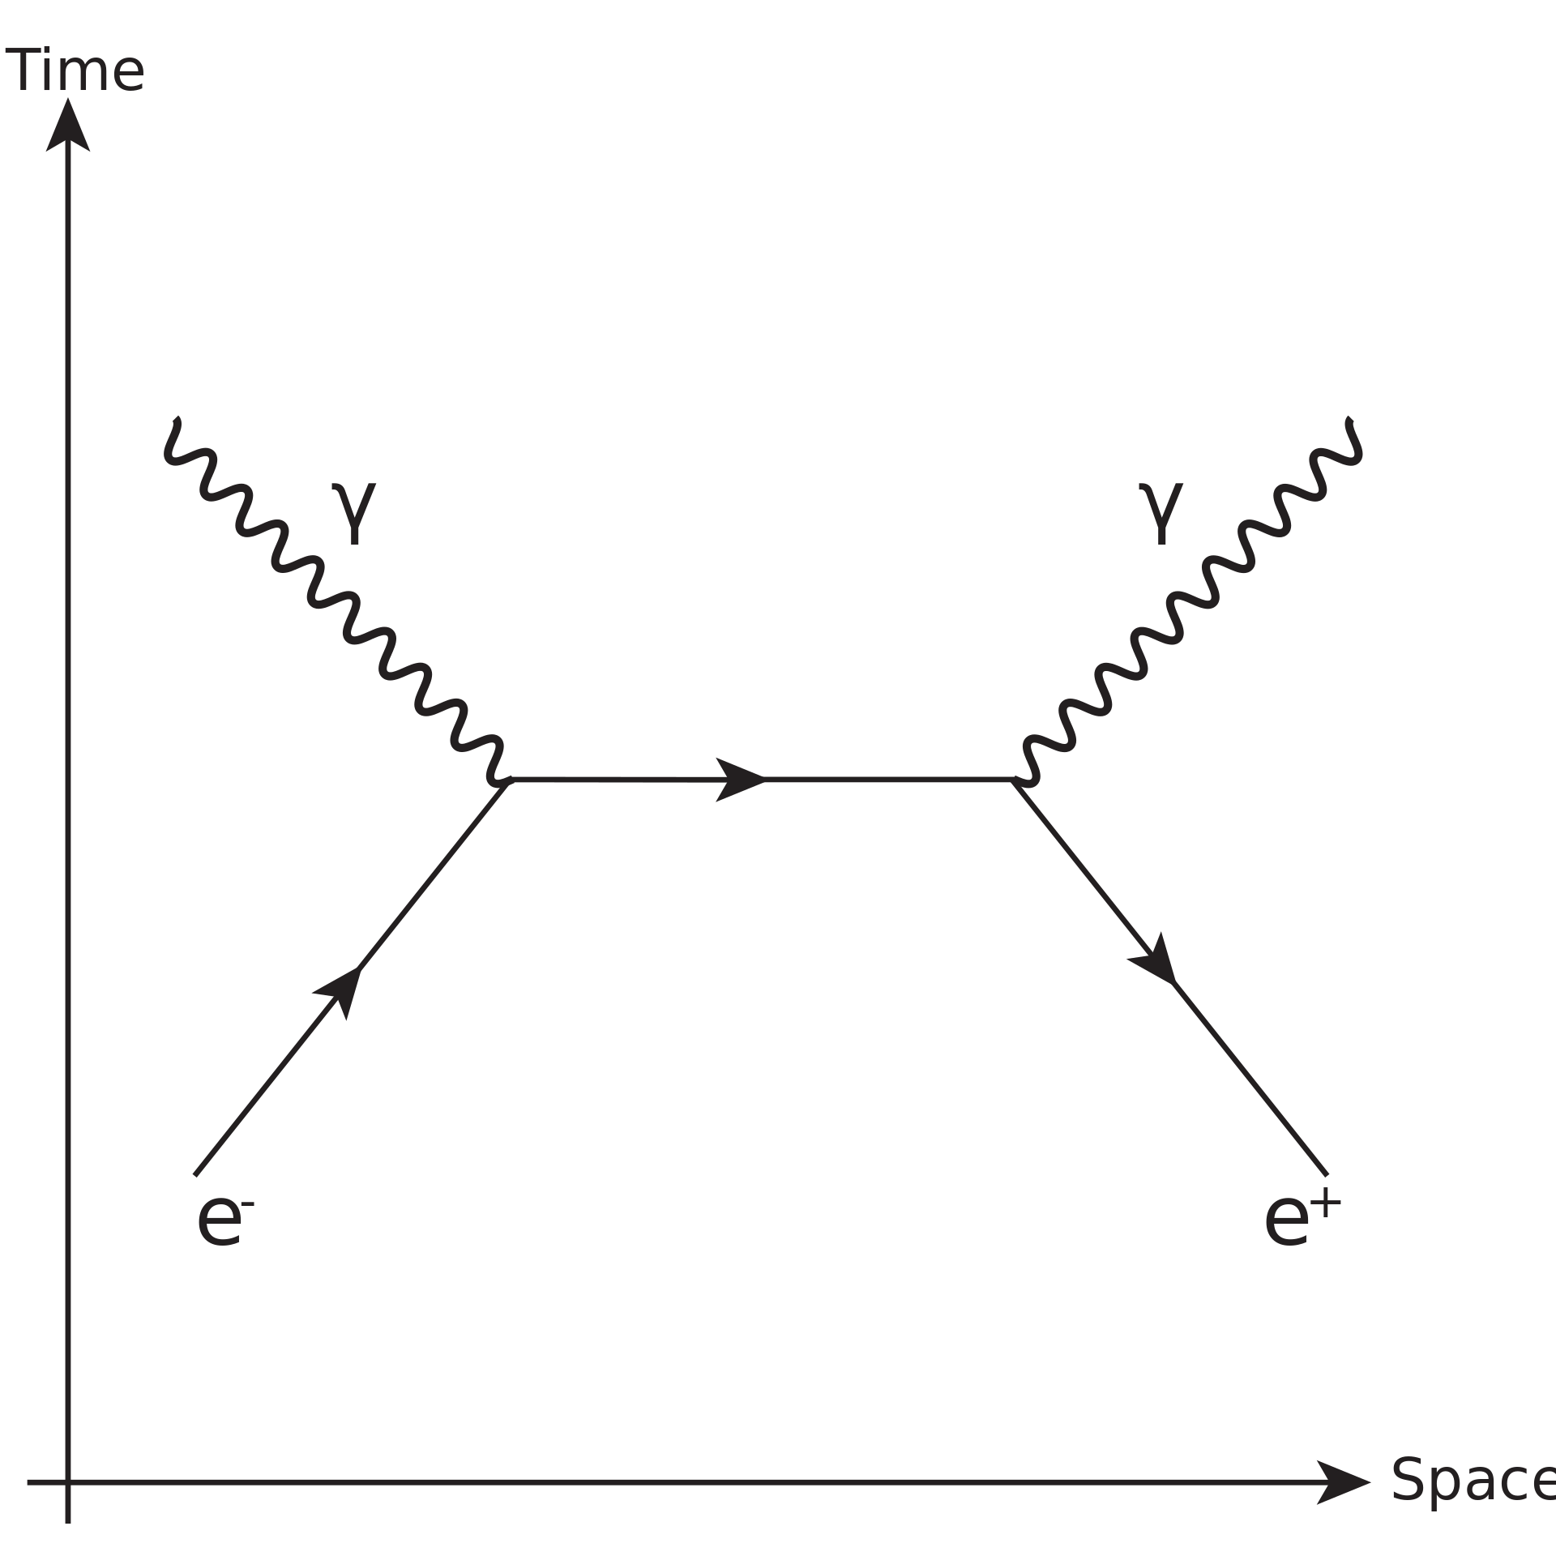
Electron-positron annihilation
When antimatter-matter pairs annihilate conservation laws must be upheld.
For electron-positron annihilation this includes conservation of charge, total energy, linear and angular momentum, and lepton number
If you take a frame of reference in which the net linear momentum of the electron and positron are zero, we can see that creating a single photon is impossible as it would have linear momentum violating conservation of linear momentum
Electron-positron annihilation will therefore always create two photons travelling in opposite directions to conserve linear momentum

Slide 41
Baryon number
All quarks have a baryon number of 1/3 (antiquarks have a baryon number of -1/3)
Baryon number is an additive number that is strictly conserved
Hadrons (particles made of quarks) must either have a baryon number of 1, 0, or -1
A hadron with a baryon number of 1 is called a baryon and would typically be made of 3 quarks
A hadron with a baryon number of 0 is called a meson and would typically be made of 1 quark and 1 antiquark
A hadron with a baryon number of -1 is called an antibaryon and would typically be made of 3 antiquarks

Slide 42
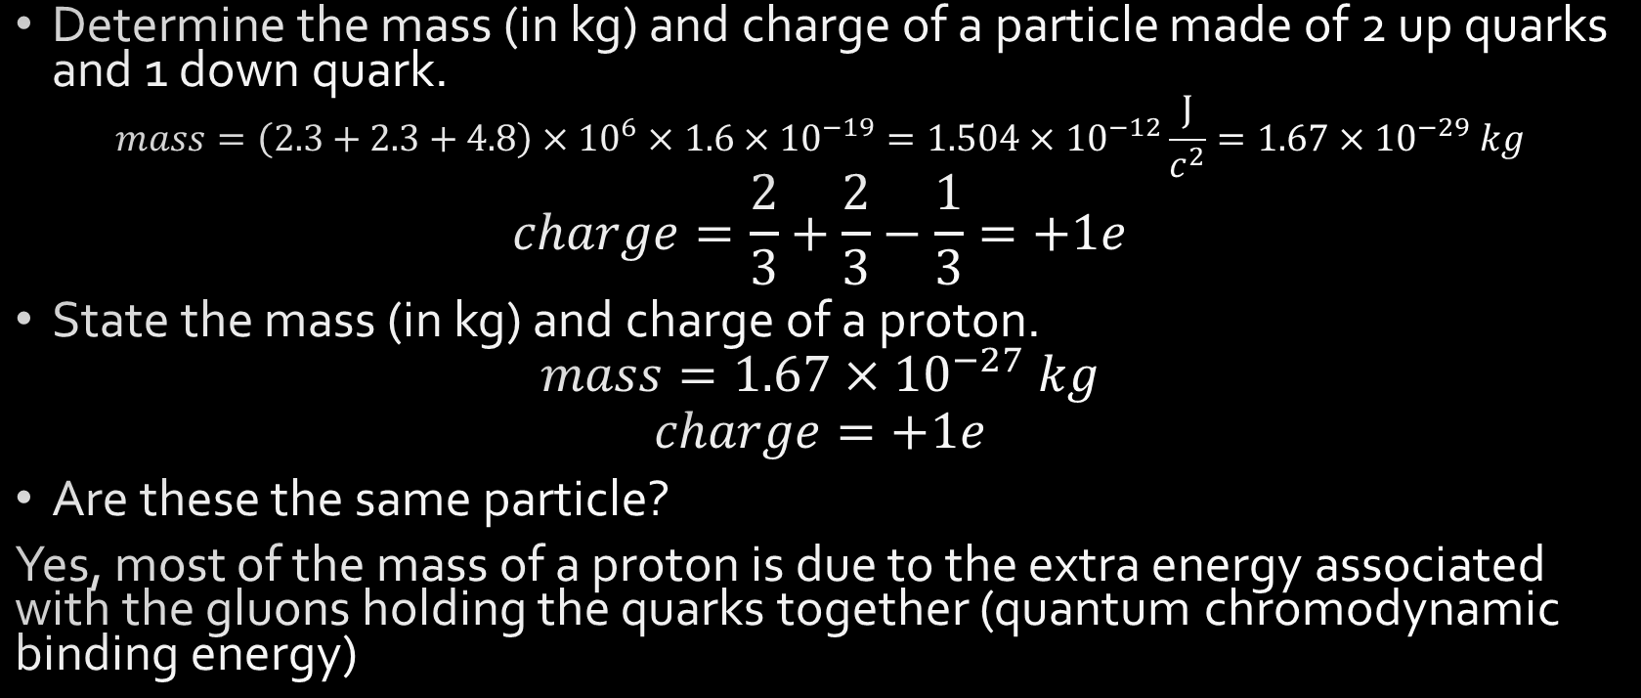
Example
Determine the mass (in kg) and charge of a particle made of 2 up quarks and 1 down quark.
$$mass=\left(2.3+2.3+4.8\right)×{10}^{6}×1.6×{10}^{−19}=1.504×{10}^{−12}\frac{J}{c^{2}}=1.67×{10}^{−29} kg$$
$$charge=\frac{2}{3}+\frac{2}{3}−\frac{1}{3}=+1e$$
State the mass (in kg) and charge of a proton.
$$mass=1.67×{10}^{−27} kg$$
$$charge=+1e$$
Are these the same particle?
Yes, most of the mass of a proton is due to the extra energy associated with the gluons holding the quarks together (quantum chromodynamic binding energy)

Slide 43
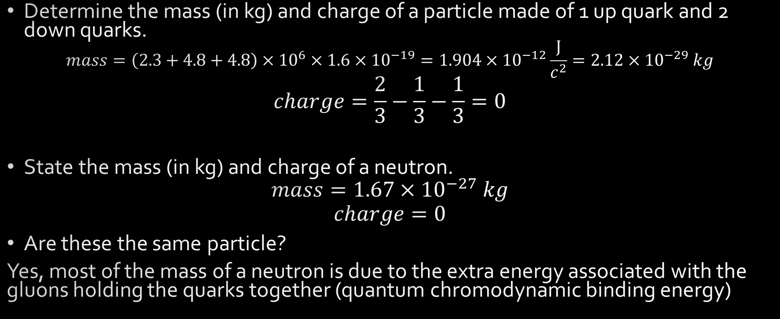
Example
Determine the mass (in kg) and charge of a particle made of 1 up quark and 2 down quarks.
$$mass=\left(2.3+4.8+4.8\right)×{10}^{6}×1.6×{10}^{−19}=1.904×{10}^{−12}\frac{J}{c^{2}}=2.12×{10}^{−29} kg$$
$$charge=\frac{2}{3}−\frac{1}{3}−\frac{1}{3}=0$$
State the mass (in kg) and charge of a neutron.
$$mass=1.67×{10}^{−27} kg$$
$$charge=0$$
Are these the same particle?
Yes, most of the mass of a neutron is due to the extra energy associated with the gluons holding the quarks together (quantum chromodynamic binding energy)

Slide 44

For each of the following quark combinations state the:
Charge
Baryon number
Whether it is possible or not
If possible, the type of particle (baryon, meson or antibaryon)
$$ut\overline{s}$$
Charge +5/3e, baryon number 1/3, not possible
$$dsc$$
Charge 0, baryon number 1, possible, baryon
$$b\overline{t}$$
Charge -1e, baryon number 0, possible, meson
$$\overline{u}\overline{c}\overline{b}$$
Charge -1e, baryon number -1, possible, antibaryon
$$uudc\overline{c}$$
Charge +1e, baryon number 1, possible, baryon

Slide 45
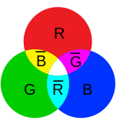
Extension - Colour charge
Baryon number is closely related to concepts known as colour charge and colour confinement
Quarks have electric charge but also ‘colour’ charge
Electric charge refers to two opposite charges that cancel out which we label positive and negative
In contrast, colour charge refers to three mutually cancelling charges – labelled red, blue and green, the 3 primary colours of light that ‘cancel’ together to white
Colour charge has literally nothing to do with light or colour in the normal sense, we just needed 3 things that together cancel out
Antiquarks have colour charge as well but take on the colours anti-red, anti-blue and anti-green (cyan, yellow and magenta respectively)
Colour confinement refers to the fact that hadrons must be colour neutral (white) at temperatures below about 1x10¹² K
Colour confinement means that lone quarks would normally not exist
e.g. 3 quarks, 1 red, 1 blue and 1 green can combine to form a white hadron (baryon)
e.g. 1 red quark and 1 antired antiquark could combine to form a white hadron (meson)
Importantly, a given quark is not locked to a specific colour charge e.g. an up quark can be red, blue or green and can change colour during its lifespan
Gluons also interact with colour charge as colour charge is related to the strong force

Slide 46
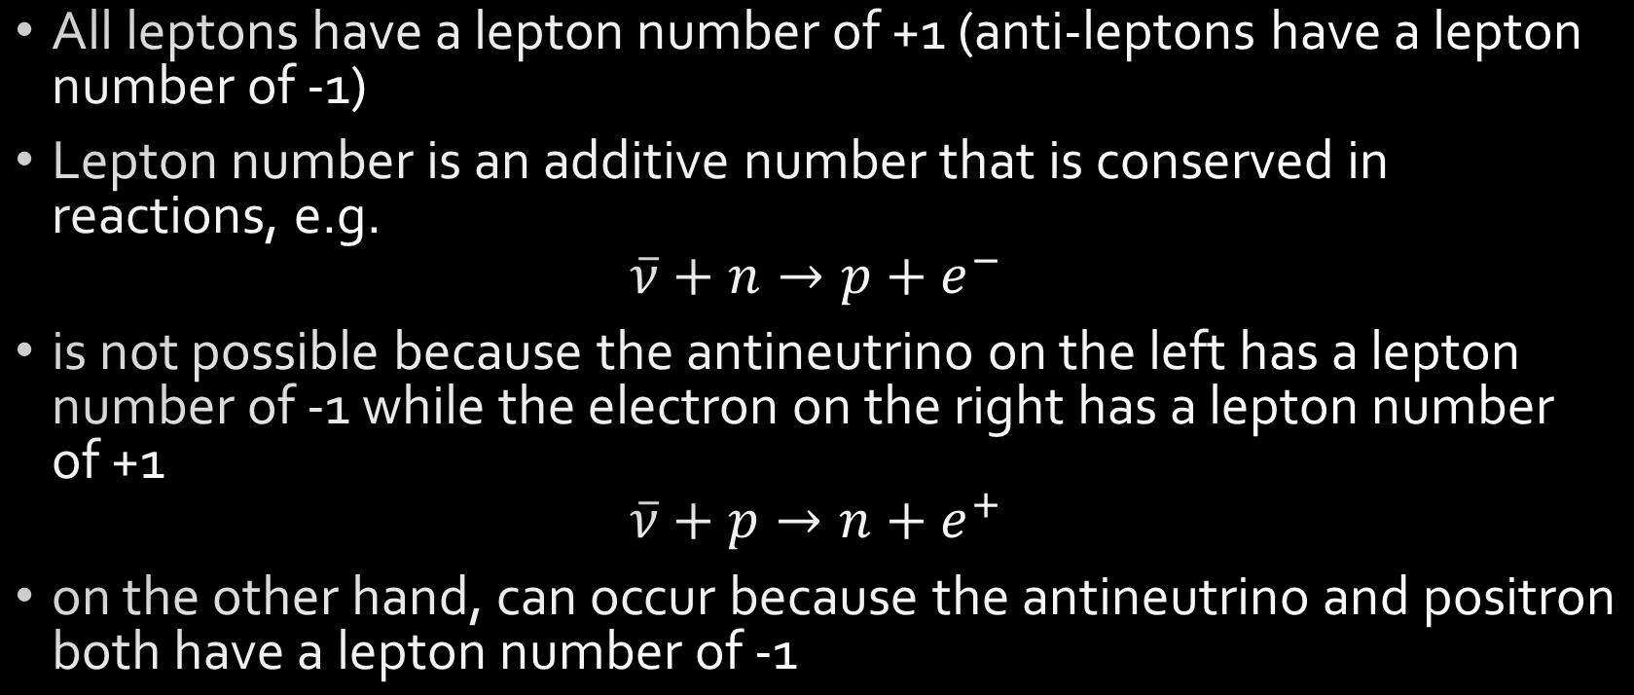
Lepton number
All leptons have a lepton number of +1 (anti-leptons have a lepton number of -1)
Lepton number is an additive number that is conserved in reactions, e.g.
$$\overline{ν}+n→p+e^{−}$$
is not possible because the antineutrino on the left has a lepton number of -1 while the electron on the right has a lepton number of +1
$$\overline{ν}+p→n+e^{+}$$
on the other hand, can occur because the antineutrino and positron both have a lepton number of -1

Slide 47
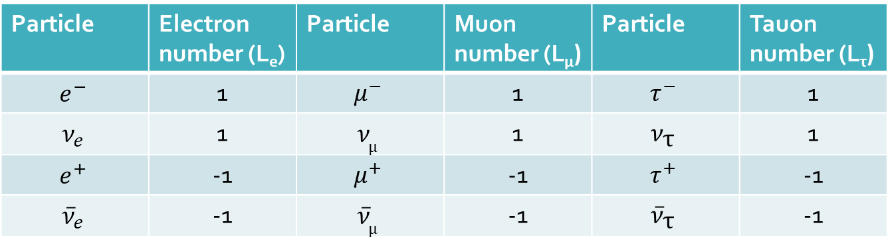
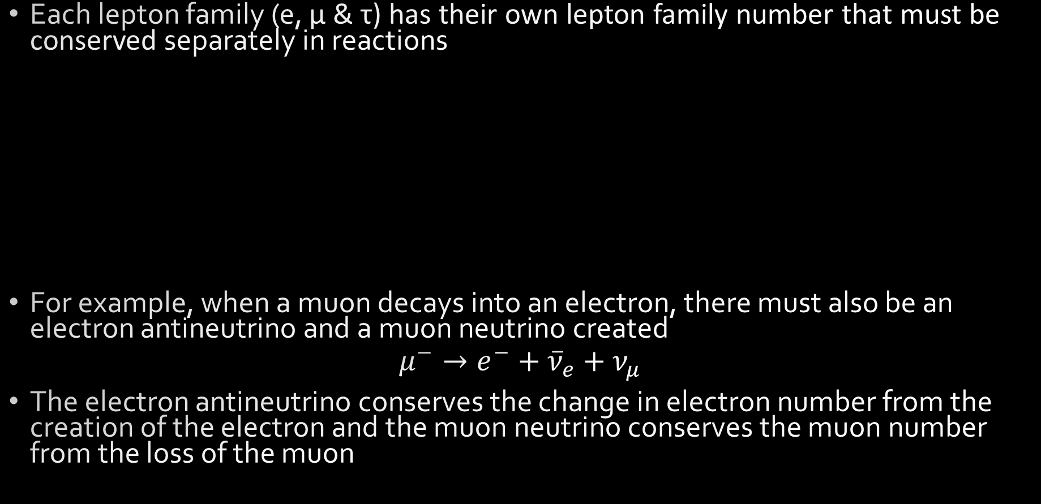
Lepton flavour conservation (e, μ & τ)
Each lepton family (e, μ & τ) has their own lepton family number that must be conserved separately in reactions
For example, when a muon decays into an electron, there must also be an electron antineutrino and a muon neutrino created
$$μ^{−}→e^{−}+{\overline{ν}}_{e}+ν_{μ}$$
The electron antineutrino conserves the change in electron number from the creation of the electron and the muon neutrino conserves the muon number from the loss of the muon
Particle | Electron number (L_{e}) | Particle | Muon number (L_{μ}) | Particle | Tauon number (L_{τ})
$$e^{−}$$ | 1 | $$μ^{−}$$ | 1 | $$τ^{−}$$ | 1
$$ν_{e}$$ | 1 | $$ν_{\text{μ}}$$ | 1 | $$ν_{\text{τ}}$$ | 1
$$e^{+}$$ | -1 | $$μ^{+}$$ | -1 | $$τ^{+}$$ | -1
$${\overline{ν}}_{e}$$ | -1 | $${\overline{ν}}_{\text{μ}}$$ | -1 | $${\overline{ν}}_{\text{τ}}$$ | -1

Slide 48

Example
Determine if lepton number would be conserved by a muon decaying into an electron, a muon neutrino and an electron antineutrino. Show full working.
$$μ→e+ν_{μ}+{\overline{ν}}_{e}$$
$$L_{e}=0=1+0−1$$
$$L_{μ}=1=0+1+0$$
$$L_{τ}=0=0+0+0$$
$$yes$$

Slide 49

Example
Determine if lepton number would be conserved by a tauon decaying into a muon, a muon neutrino and a tau neutrino. Show full working.
$$τ^{−}→μ^{−}+ν_{μ}+ν_{τ}$$
$$L_{e}=0=0+0+0$$
$$L_{μ}≠0=1+1+0$$
$$L_{τ}=1=0+0+1$$
$$no$$

Slide 50

Example
Considering conservation of charge, baryon number and lepton number determine if the reaction below is possible. A proton decays to form a neutron, positron and electron neutrino. Show full working.
$$p→n+e^{+}+ν_{e}$$
$$charge=1=0+1+0$$
$$baryon number=1=1+0+0$$
$$L_{e}=0=0−1+1$$
$$so yes$$

Slide 51
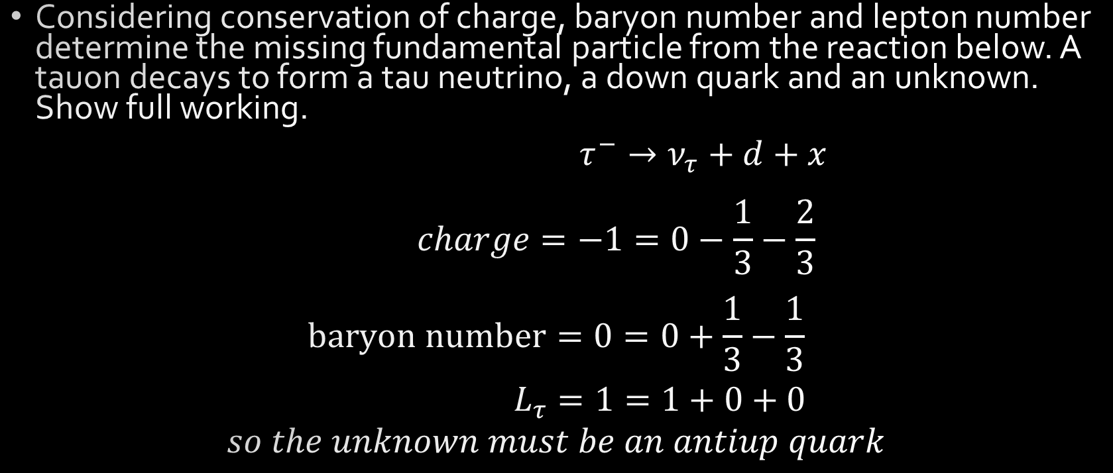
Example
Considering conservation of charge, baryon number and lepton number determine the missing fundamental particle from the reaction below. A tauon decays to form a tau neutrino, a down quark and an unknown. Show full working.
$$τ^{−}→ν_{τ}+d+x$$
$$charge=−1=0−\frac{1}{3}−\frac{2}{3}$$
$$baryon number=0=0+\frac{1}{3}−\frac{1}{3}$$
$$L_{τ}=1=1+0+0$$
$$so the unknown must be an antiup quark$$

Slide 52
Fundamental forces summary
 | Strong | Electromagnetism | Weak | Gravity
Range: | Short | Long (inverse square) | Short | Long (inverse square)
Strength: | Strongest | Strong | Weak | Weakest
Carrier: | Gluons (and mesons) | Photons | W⁺, W⁻ and Z⁰ bosons | Gravitons?
Responsible for: | Binding quarks together to form hadrons Binding hadrons together to form nuclei | Binding electrons to nuclei to form atoms, binding atoms together to form molecules/lattices - chemistry, electronics, light | Mediating beta decay and other interactions including neutrinos | Forming stars, planets, black holes, galaxies etc.

Slide 53
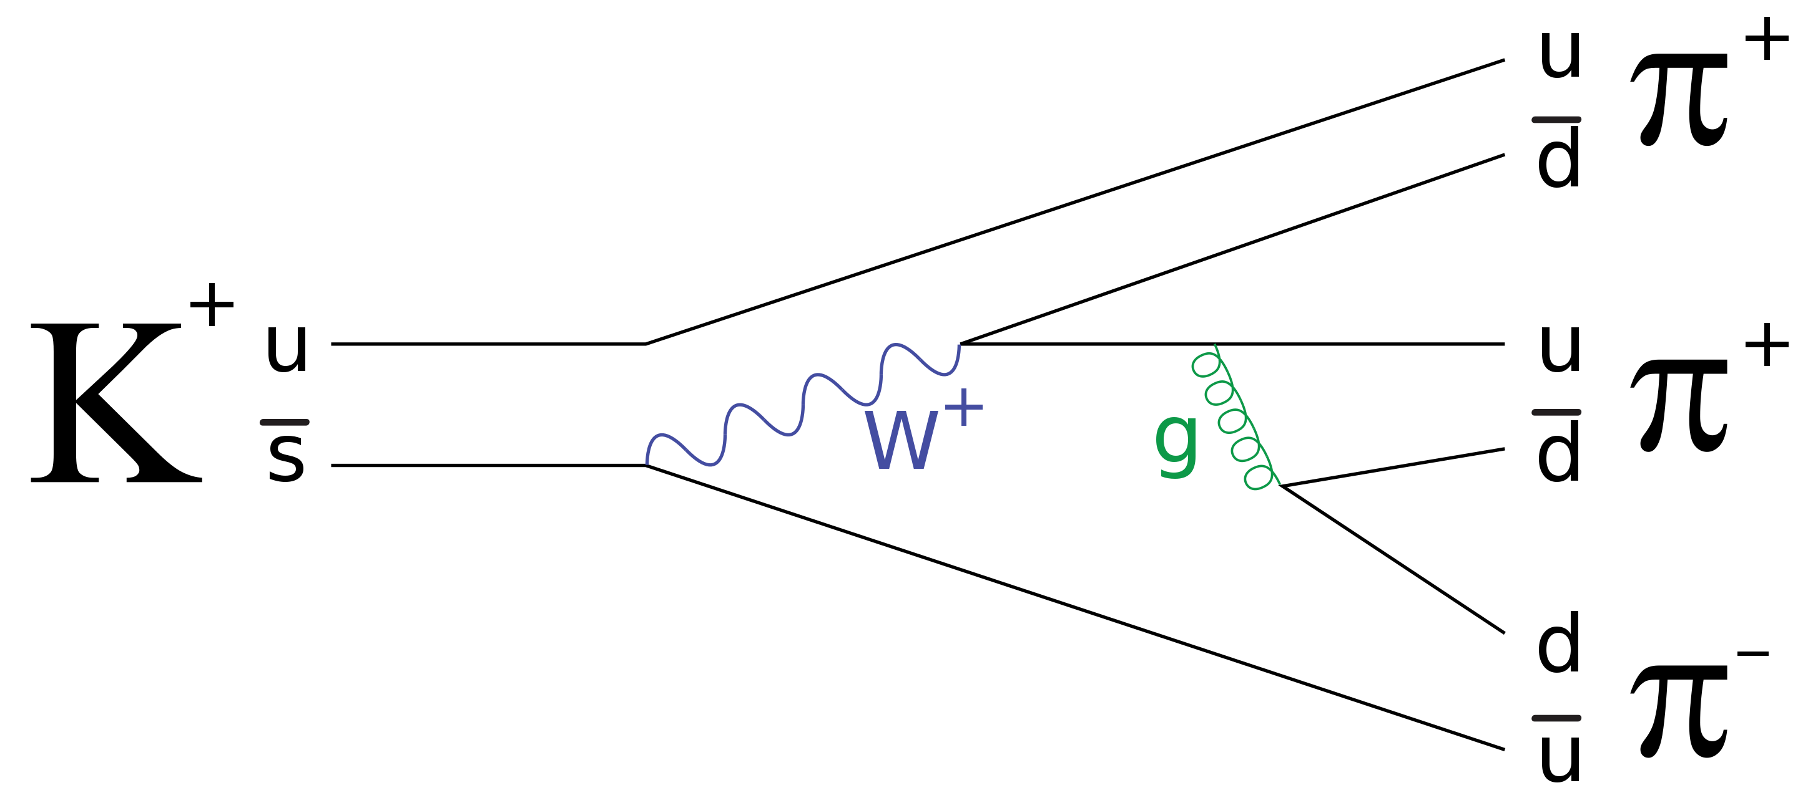
Extension - Feynman diagrams
Diagrams represents quantum field theory processes in terms of particle interactions – pictorial representations of advanced mathematics
Time is typically drawn with time progressing upwards but sometime shown with time progressing to the right
Shows interactions over time typically including incoming particles at the beginning, outgoing particles at the end and temporary virtual particles in between
Quarks and leptons are drawn as arrows with the direction pointing with the progression of time – antimatter particles are drawn as if moving backwards through time
Don’t show much in the way of spatial information

Slide 54
The strong force – gluons (and mesons)
u (blue)
d (green)
The strong force bonds quarks together into hadrons e.g. protons and neutrons
The strong force between nucleons is mediated by gluons which have no mass or electric charge but do carry colour charge
The strong force also bonds neutrons and protons together to form nuclei but this is mediated by mesons rather than gluons
Gluons and mesons both carry a colour and an anti-colour
Gluons do not have antimatter versions (could be thought of as a matter-antimatter hybrid particles)
g (green-antiblue)
u (green)
d (blue)

Slide 55
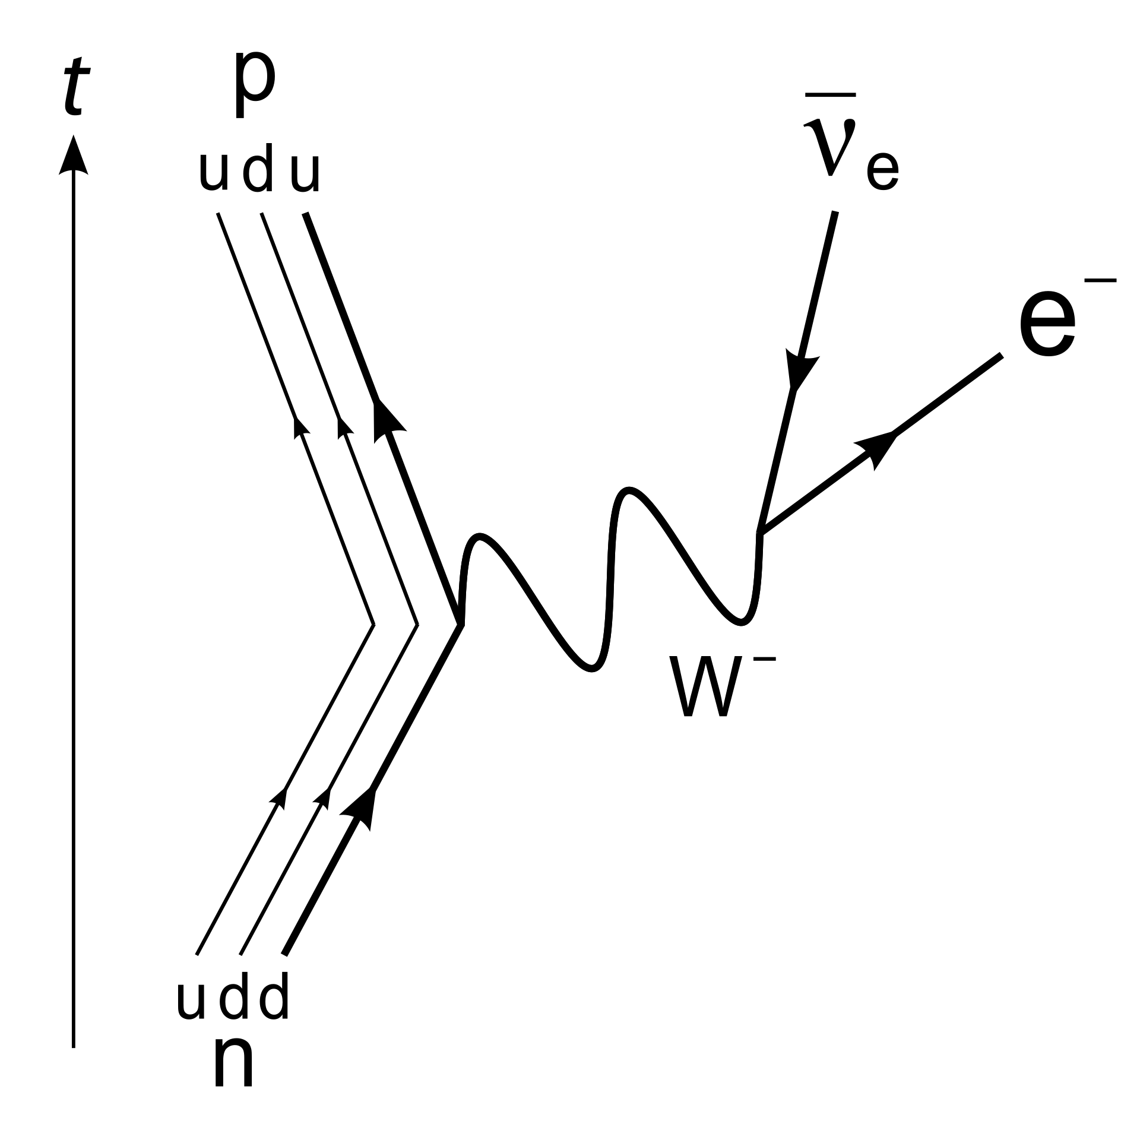
The weak interaction – W⁺, W⁻ and Z⁰ bosons
The W and Z bosons mediate the weak force or interaction
W± bosons mediate the emission and absorption of neutrinos in processes such as Beta decay transferring electric charge, momentum and/or energy
Z bosons transfer momentum and/or energy (and spin) in processes such as elastic scattering of neutrinos
The W and Z bosons have mass unlike photons and gluons

Slide 56
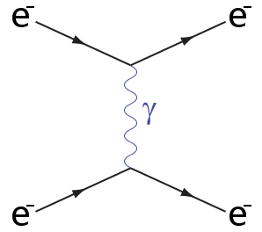
Electromagnetism - photons
A very wide range of familiar interactions such as electrostatic repulsion are mediated by virtual photons
The virtual photon transfers energy and/or momentum but no electric charge or colour charge

Slide 57
Combining the Big Bang with the Standard Model
The Big Bang suggests that in the early universe the density of energy was extremely high
Particle accelerators let us model extremely high energy situations and investigate particle interactions and stability under those conditions
Can be thought of as letting us look back in time at what the universe may have been made of under those conditions
This gives us some insight into the evolution of matter and the universe after the Big Bang

Slide 58
Epoch/Event | t | T | Forces | Matter | Other details
Planck | <10⁻⁴³ s | >10³² K | Quantum gravity? | Energy?
Grand unification | <10⁻³⁶ s | >10²⁹ K | Gravity and Electronuclear | Fundamental particles | Matter-antimatter pairs created, slightly more matter created
Electroweak | <10⁻³² s | >10²² K | Gravity, Strong and Electroweak
Quark | 10⁻¹² ~ 10⁻⁶ s | >10¹² K | Gravity, Strong, Weak and Electromagnetism | Quark-gluon plasma | These conditions are the highest energy directly observable in the LHC
Hadron | 10⁻⁶ ~ 1 s | >10¹⁰ K |  | Hadrons form | Quark matter-antimatter annihilation small remainder of matter quarks
Nucleosynthesis | 10 ~ 10³ s | >10⁷ K |  | H, He and Li form | Universe hot enough for fusion but cool enough for H-2 to be stable
Photon | 10 s ~ 370 ka | >4000 K |  | Photons dominate | Lepton matter-antimatter annihilation small remainder of matter leptons
Recombination | 370 ka | 4000 K |  | Neutral atoms form | Electrons combining with nuclei release excess energy as photons now visible as CMBR
Dark ages | 370 ka ~150 Ma | >60 K |  |  | Slight variation in spread of matter allows gravity to form clumps
Star and galaxy formation | ~ 250 Ma | 60 K |  | Heavier elements form | Gravity compresses clumped matter making stars

Slide 59
Evolution of forces
Possible total unification of force (Theory of Everything?)
Gravity and Electronuclear force (Grand Unification)
Gravity, Strong and Electroweak forces
Gravity, Strong, Weak and Electromagnetism

Slide 60
Evolution of matter
Energy
Matter-antimatter pair creation of fundamental particles
Quark-antiquark annihilation, formation of hadrons from remaining quarks
Formation of light nuclei (H, He, Li) from hadrons
Lepton-antilepton annihilation
Formation of neutral atoms from light nuclei and remaining electrons
Formation of heavier nuclei in stars

